Slide 1
MARKET RESEARCH AND GTM STRATEGY
Canadian Digital Marketing Firm

Slide 2
EXECUTIVE SUMMARY
Company Overview:
The company is a Canadian digital marketing firm seeking to expand its business into the U.S. market.
Market Opportunity:
High-growth cities in united states show untapped growth potential for Digital Marketing in trade sector.
GTM Strategy:
The go-to-market strategy focuses on capturing market share through robust market research, strategic positioning, and effective brand awareness campaigns tailored to diverse business needs.
Goals:
Achieve rapid customer acquisition, acquire market share, and drive scalable growth with a strong focus on customer satisfaction.

Slide 3
RECOMMENDATIONS
Choose Raleigh as Entry Point
Track ROI of marketing efforts
Expand the business to Boise based on the outcomes from Raleigh

Slide 4
OVERVIEW
1
Scope of Analysis
5
Marketing Strategy
2
Market Analysis
6
Financial Modelling & Budget planning
3
Competitor Analysis
7
Risks
4
Entry Strategy
8
Questions?

Slide 5
01
SCOPE & METHODOLOGY

Slide 6




SCOPE OF ANALYSIS
Market
Dynamics
Competitive Landscape
Regional Prioritization
Risk and Opportunity Analysis
Customer Insights

Slide 7



METHODOLOGY
Phase 2:
Primary Research and Customer Outreach
Phase1:
Market Research and Industry Analysis
Phase 3:
Competitor Benchmarking
Phase 4:
City Selection Framework

Slide 8
02
MARKET ANALYSIS

Slide 9


UNDERSTANDING THE MARKET LANDSCAPE
Objective:
To identify high-growth markets with untapped potential for digital marketing services tailored to contractors.
Process:
Analyzed construction trends in 10 high-growth cities. Conducted qualitative interviews with contractors to uncover challenges and needs.

Slide 10



HOW WE IDENTIFIED OUR FOCUS CITIES
Key Criteria for City Selection:
Population growth exceeding 120k.
High investment in new housing and commercial projects.
Economic vibrancy with rising household incomes.
Top 10 Cities Identified: Wilmington, NC; Austin, TX; Raleigh, NC; Boise, ID; Jacksonville, FL; Nashville, TN; Houston, TX; Phoenix, AZ; Atlanta, GA; New York City, NY.
Rationale for Raleigh & Boise:
Raleigh: A tech-driven, moderate-budget market open to advanced digital strategies.
Boise: A rapidly growing, budget-conscious market relying heavily on referrals.

Slide 11


PERSONALIZED INSIGHTS FROM CONTRACTORS
Methodology:
One-on-one phone interviews with contractors.
Open-ended questions covering marketing practices, challenges, and priorities.
Focus on Quality Over Quantity:
While the sample size was small, interviews provided in-depth, actionable insights.
Responses highlighted recurring themes and key pain points.

Slide 12



RALEIGH: A BALANCED DIGITAL MARKET
Contractor Insights:
Social media and email marketing are widely used but need optimization.
Budgets range from $1,000–$3,000 monthly, indicating willingness to invest.
Key challenge:
Difficulty generating high-quality leads.
Opportunities:
Advanced analytics tools to track ROI.
Lead optimization strategies tailored to contractor needs.

Slide 13
BOISE: A TRADITIONAL BUT EVOLVING MARKET
Contractor Insights:
Heavy reliance on word-of-mouth and referrals.
Budgets below $500 monthly, highlighting cost sensitivity.
Key challenge:
High advertising costs with limited digital ROI.
Opportunities:
Entry-level packages for social media and referrals.
Workshops to improve digital marketing literacy.

Slide 14


SHARED CONTRACTOR CHALLENGES
Low-quality leads from current channels.​
High advertising costs impacting ROI.​
Lack of actionable analytics and insights.​

Slide 15
TRANSLATING INSIGHTS INTO STRATEGY
Raleigh and Boise represent distinct yet complementary markets.
Qualitative data from interviews guides tailored solutions:
  Advanced tools for Raleigh.
  Affordable, high-impact strategies for Boise.

Slide 16


OUR RECOMMENDATION
Choose Raleigh as
Entry point
Expand to Boise based on business outcomes from Raleigh

Slide 17
03
COMPETITOR ANALYSIS

Slide 18


Standing Out in Raleigh's Competitive Digital Marketing Landscape
Objective:
To analyze Raleigh's digital marketing space, identifying opportunities for differentiation.
Process:
Studied six key competitors and evaluated gaps in their service offerings.

Slide 19
HOW WE IDENTIFIED COMPETITORS
Key Criteria for City Selection:
Presence in the Raleigh market.
Focus on small to mid-sized businesses or niche sectors.
Use of innovative digital marketing technologies.
Competitors Identified:
Bluevine (Enterprise Marketing)
Nover Marketing (Local/Niche Strategies)
Builder Funnel (Construction/Home Improvement)
Johnson Jones Group (Branding Experts)
FatCat Strategies (Small Business Focus)
Builders Agency (Affordable Niche Marketing)

Slide 20
BLUEVINE
Strengths:
Comprehensive strategies for large-scale enterprise needs, leveraging advanced analytics.
Weaknesses:
Limited appeal for small businesses seeking cost-effective solutions.
Opportunities for The company:
Affordable AI-driven strategies for SMBs.
Transparent tiered pricing to attract budget-conscious clients.

Slide 21
NOVER MARKETING
Strengths:
Tailored, localized solutions; strong client relationships.
Weaknesses:
Lack of scalability and innovation in technology.
Opportunities for The company:
Scalable solutions incorporating cutting-edge tools.
Industry-specific innovations to broaden appeal.

Slide 22
Builder Funnel
Strengths:
Expertise in content creation, SEO, and lead generation for construction.
Weaknesses:
Limited focus outside the construction sector; lacks versatility.
Opportunities for The company:
Create broader industry-specific strategies with advanced analytics tools.

Slide 23
JOHNSON JONES GROUP
Strengths:
High-impact branding campaigns; strong narrative-driven marketing.
Weaknesses:
Premium pricing and strategy focus over measurable ROI.
Opportunities for The company:
Emphasize ROI-focused strategies to attract cost-conscious clients.
Develop performance-based metrics to complement branding efforts.

Slide 24
FATCAT STRATEGIES
Strengths:
Affordable marketing packages; effective local SEO and lead generation.
Weaknesses:
Limited scalability and service range.
Opportunities for The company:
Expand service range to include scalable, advanced digital solutions.
Position as a comprehensive marketing partner for growing businesses.

Slide 25
BUILDERS AGENCY
Strengths:
Affordable and targeted marketing for construction/home services.
Weaknesses:
Lack of advanced tools and diverse service offerings.
Opportunities for The company:
Introduce AR campaigns and advanced testing tools.
Develop cost-effective packages that cater to a broader range of industries.

Slide 26
Challenges in the Current Competitive Landscape
Limited Specialization in Emerging Technologies:
  Competitors lack focus on advanced tools like AI-driven analytics and personalized automation.
Lack of Transparent Pricing:
  Absence of clear, predictable pricing models deters small to mid-sized businesses.
Technological Innovation Gap:
  Few competitors leverage innovative strategies such as augmented reality campaigns or advanced A/B testing tools.
Customer Dissatisfaction:
  Feedback shows dissatisfaction with rigid marketing strategies and infrequent performance reviews.

Slide 27
Key Strengths to aim for in-order to stand Out
Integration of Advanced Technologies:
Leverage AI and automation for hyper-personalized solutions.
Invest in innovative tools like augmented reality and advanced analytics to drive measurable ROI.
Transparent and Flexible Pricing Models:
Offer clear, tiered pricing to attract diverse SMB clients.
Provide adaptable packages tailored to client needs and budgets.
Client-Centric Growth Partnership:
Build collaborative relationships through regular performance reviews and feedback.
Empower clients with workshops and training, positioning The company as a trusted partner.

Slide 28
ENTRY STRATEGY
04

Slide 29
MARKET ENTRY STRATEGY
SUGGESTED ENTRY STRATEGY:
Direct Market Entry:
  Set up a U.S. office or partner with local consultants/agencies to establish credibility and presence.
Partnerships:
  Collaborate with trade organizations, industry associations, or local digital marketing agencies to co-deliver services.

Slide 30

OUR RECOMMENDATION
We recommend direct market entry as opposed to collaborations with existing digital marketing business.

Slide 31
Alternative Entry Strategies
Partnering with other digital marketing agencies
  Not recommended due to profitability issue
Business Acquisition
  Not recommended due to Budget Constraints

Slide 32
STRATEGY FOR RALEIGH
ESTABLISHING A STRONG LOCAL PRESENCE
Physical Office Setup
  Establish an office in Raleigh to tap into its thriving economy and booming real estate market.
  Utilize the space for client workshops, consultations, and live demonstrations of analytics dashboards.
Specialized Local Team
  Build a dedicated team focused on lead generation, localized SEO, and social media strategies tailored for contractors.
  Strengthen the local network by hiring professionals with deep connections to Raleigh's contractor and business community.
Community Engagement
  Use the office to host free workshops and seminars, creating touchpoints with potential clients while showcasing industry expertise.

Slide 33
STRATEGY FOR RALEIGH
TARGETED RECRUITMENT AND STRATEGIC PARTNERSHIPS
Recruitment
  Hire professionals familiar with Raleigh’s contractor networks and trends.
  Leverage their expertise to navigate local nuances and establish trust within the community.
Partnerships with business networks
  Collaborate with the Raleigh Chamber of Commerce and small business centers to enhance visibility.
  Participate in local initiatives to position the business as an integral part of the community.

Slide 34
STRATEGY FOR RALEIGH
LEVERAGING PARTNERSHIPS FOR GROWTH
Trade Organizations and Real Estate Associations
  Partner with influential groups like the North Carolina Association of REALTORS®️ to access contractor and real estate networks.
  Sponsor industry events such as expos and forums to boost credibility and visibility.
Collaborating with Local Marketing Firms
  Form alliances with Raleigh-based real estate marketing firms to deliver co-branded campaigns or offer white-label services.
  Focus on high-demand offerings like SEO to meet contractor needs.
  Utilize platforms such as Zillow, Facebook Marketplace, and Google Local Ads to amplify visibility and target leads effectively.

Slide 35
MARKETING STRATEGY
05

Slide 36
PRINT MEDIA ADVERTISING AND TRADE MAGAZINES FOR TARGETING CONTRACTORS
Design Engaging Advertisements​
  Focus on Pain Points: Highlight challenges contractors face, like finding leads, managing online reputation, or standing out in a competitive market.​
  Showcase Solutions: Emphasize how your digital marketing services (e.g., localized SEO, lead generation, or virtual staging) can directly address these needs.​
  Include CTAs: Ensure a clear call-to-action like "Schedule a Free Consultation" or "Claim Your Free Marketing Audit."​
  Use QR Codes: Add scannable codes to connect print readers to a landing page or promotional offer.​

Slide 37
PRINT MEDIA ADVERTISING AND TRADE MAGAZINES FOR TARGETING CONTRACTORS
Feature Case Studies or Testimonials
  Dedicate ad space to a success story or client testimonial from a contractor.
  Use metrics to show tangible results (e.g., "Increased leads by 50% within 3 months").
Collaborate on Special Features
  Sponsor a section in the magazine, such as a "Contractor Spotlight," where you highlight successful contractors and subtly promote your services.
  Co-brand content like "Top Marketing Tips for Home Improvement Professionals."

Slide 38
PARTNER WITH LOCAL CONTRACTOR ASSOCIATIONS TO EXPOSURE THE BRAND TO THE POTIENTIAL CLIENT
Collaborate with Local Marketing Promotion Firm
  Co-branding Opportunities: Work with Raleigh-based firms to co-develop campaigns or white-label services.
  In-demand Services:
    Offer drone photography, SEO optimization, and virtual staging.
    Highlight tailored services for contractors to attract more leads.
  Leverage Digital Channels:
    Utilize platforms like Zillow, Facebook Marketplace, and Google Local Ads to amplify reach.
    Run complementary online campaigns targeting the same audience to enhance brand recall.

Slide 39
PRINT MEDIA ADVERTISING AND TRADE MAGAZINES FOR TARGETING CONTRACTORS
Network with Contractors through the Association
  Build long-term relationships with contractor associations like the North Carolina Association of REALTORS®.
  Leverage the association’s database to identify potential contractors.
  Create targeted campaigns to promote collaborative benefits.
Sponsor Events to Exposure the Brand
  Host or sponsor contractor expos, community forums, or networking luncheons.
  Provide branded materials or tools to attendees (e.g., guides, brochures).
  Use event sponsorships to build credibility and increase local visibility.

Slide 40
EFFECTIVE USE OF PRINT MEDIA ADVERTISING AND TRADE MAGAZINES FOR TARGETING CONTRACTORS
Offer Educational Content
  Create mini-guides or how-to articles relevant to contractors (e.g., "How to Use Google Local Ads Effectively").
  Provide actionable insights to demonstrate expertise and attract interest.
Combine Print and Digital Efforts
  Use print ads to drive traffic to your website or social media through trackable links or QR codes.
  Launch complementary online campaigns targeting the same audience to reinforce brand recall.

Slide 41
BE THE PARTNER OF LOCAL CONTRACTOR ASSOCIATIONS TO EXPOSE THE BRAND TO THE POTENTIAL CLIENT
Offer Free Marketing “Deserts” to Let the Contractors Know the Benefits.
  Create customized digital marketing toolkits for contractors to enhance their outreach efforts.
  Include resources such as website templates, social media strategies, and advertising guides.
  Showcase real-life success stories to demonstrate value.

Slide 42
TRACKING ROI

Slide 43
Tracking ROI
  Ensure ROI tracking to understand the effectiveness of marketing and advertising
  We recommend you track in the following ways

Slide 44
SN | MARKETING CHANNELS | SUGGESTED ROI TRACKING SOLUTIONS
1 | Re-seller Partnerships | Track new client acquisitions linked to partnerships. Measure revenue per partnership against incentives provided. Use unique codes or discounts for clients brought in through partnerships.
2 | Referrals & Word of Mouth | Implement a referral program with unique codes to identify customers brought through referrals. Use customer feedback surveys to ask how they heard about the company.
3 | Personal Connections & Networking | Use a CRM to log clients sourced through networking events. Track conversion rates for leads generated via business meetings or events like BNI or Chambers.

Slide 45
SN | MARKETING CHANNELS | SUGGESTED ROI TRACKING SOLUTIONS
4 | SEO | Use tools like Google Analytics and SEMrush to monitor organic traffic growth. Track lead conversions on landing pages optimized for SEO keywords.
5 | Paid Ads | Set up conversion tracking in Google Ads and Meta Ads Manager. Track CPC (Cost Per Click), CPA (Cost Per Acquisition), and total ROAS (Return on Ad Spend). Use A/B testing to optimize campaigns and maximize ROI.
6 | LinkedIn (Posts and Outreach) | Use LinkedIn Analytics to track engagement, profile views, and clicks on posts. Measure conversions from LinkedIn campaigns by tracking leads from outreach messages using CRM.

Slide 46
SN | MARKETING CHANNELS | SUGGESTED ROI TRACKING SOLUTIONS
7 | Telemarketing | Log calls in CRM and track call-to-lead and call-to-sale conversion rates. Measure the ROI of telemarketing by comparing revenue generated to call center costs.
8 | Trade Shows | Use platform-specific analytics (Meta, Twitter, Instagram) to track post engagement, clicks, and traffic. Measure social media-driven leads in CRM to calculate ROI.
9 | Walk-ins, Door Knocking | Use tracking forms or customer intake forms to attribute leads to these channels. Measure conversion rates and the average value of leads acquired through offline efforts.
10 | Online Webinars/Presentations | Use webinar tools like Zoom or Demio to track registration and attendance. Monitor conversions post-webinar via follow-up emails or campaigns.

Slide 47
FINANCIAL MODEL & BUDGET PLANNING
06

Slide 48
FINANCIAL MODEL
Summary Analysis | FY2025 | FY2026 | FY2027 | FY2028 | FY2029
Total Revenue | 435,471 | 500,791 | 575,910 | 662,297 | 761,641
Total Costs | 304,830 | 350,554 | 403,137 | 463,608 | 533,149
Gross Profit | 130,641 | 150,237 | 172,773 | 198,689 | 228,492
Net Profit | 30,641 | 50,237 | 72,773 | 198,689 | 228,492
Investment Analysis | Totals
Net Present Value (NPV) | 301,633
Internal Rate of Return (IRR) | 10%
Payback Period | 1 Year
Return on Investment (ROI) | 294%

Slide 49
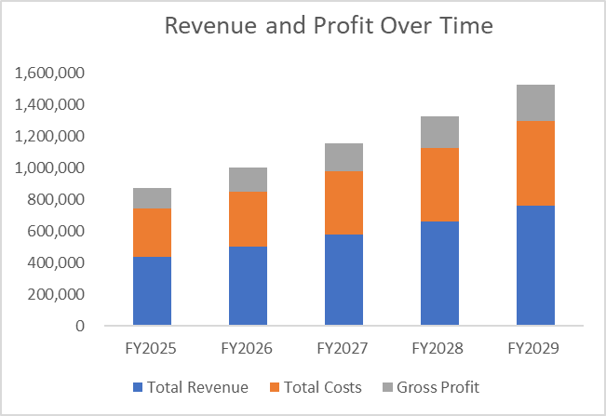

Slide 50
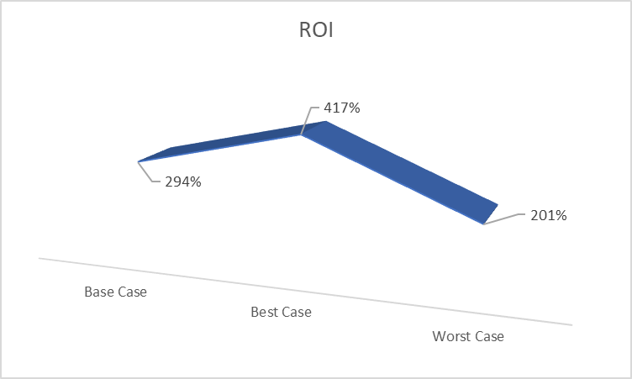
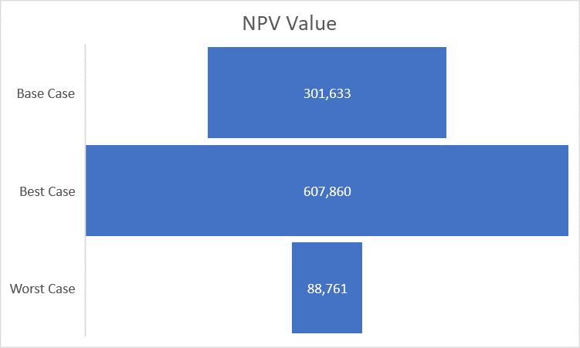
FINANCIAL MODEL

Slide 51
$100,000 budget designed to ensure a strong market entry in Raleigh's competitive digital marketing sector.
Our plan emphasizes building a skilled team, establishing a functional presence, and driving impactful marketing efforts.
BUDGET PLANNING

Slide 52
Category | Subcategory | Budget
Business Setup & Legal Fees | Registration, Legal Consultation | $10,000
Office Space & Utilities | Lease, Utilities, Supplies | $20,000
Technology & Equipment | Essential Hardware/Software | $3,000
Staffing | Salaries, Training | $47,000
Marketing & Advertising | Website, Online Ads | $15,000
Miscellaneous Expenses | Insurance, Contingency | $5,000
Business Travel & Logistics | Travel Coordination | $5,000

Slide 53
Key Priorities and Justification
Strategic staffing allocation ensures service quality.
Focused marketing to build brand awareness and acquire clients.
Efficient use of resources from Canada’s main office minimizes technology costs.
Business travel ensures seamless coordination between locations.

Slide 54
07
RISKS

Slide 55
RISKS
Lack of numerical data w.r.t relevant cost and opportunity costs could affect optimal pricing and profitability calculations
Current lack of data w.r.t Marketing ROI for The company hinders optimal marketing strategy prediction
Budget for additional market research not accounted in budget planning

Slide 56
Immediate Action
Track fixed costs and variable costs for existing products
Conduct pricing analysis
Record Marketing effects to understand Marketing ROI, customer acquisition and customer retention

Slide 57
THANKS!
ANY QUESTIONS?

